Slide 1
Cloud Print Demo
TOSHIBA
Tardis ( Clara/ Amy)

Slide 2
Cloud Print Server
TOSHIBA
Install node js on local machine https://nodejs.org/en/download/
Install pm2 on local machine using “npm install –g pm2”
Reference: https://pm2.keymetrics.io/docs/usage/process-management/
** If Cloud print client is done setup, please skip above steps
3. Copy CloudPrintServer folder to local machine

Slide 3
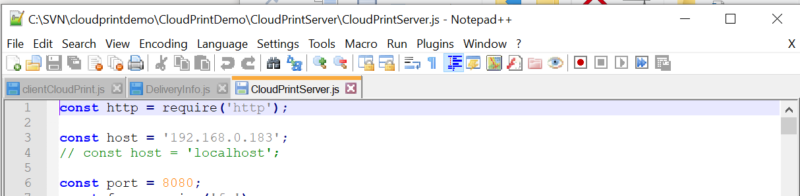
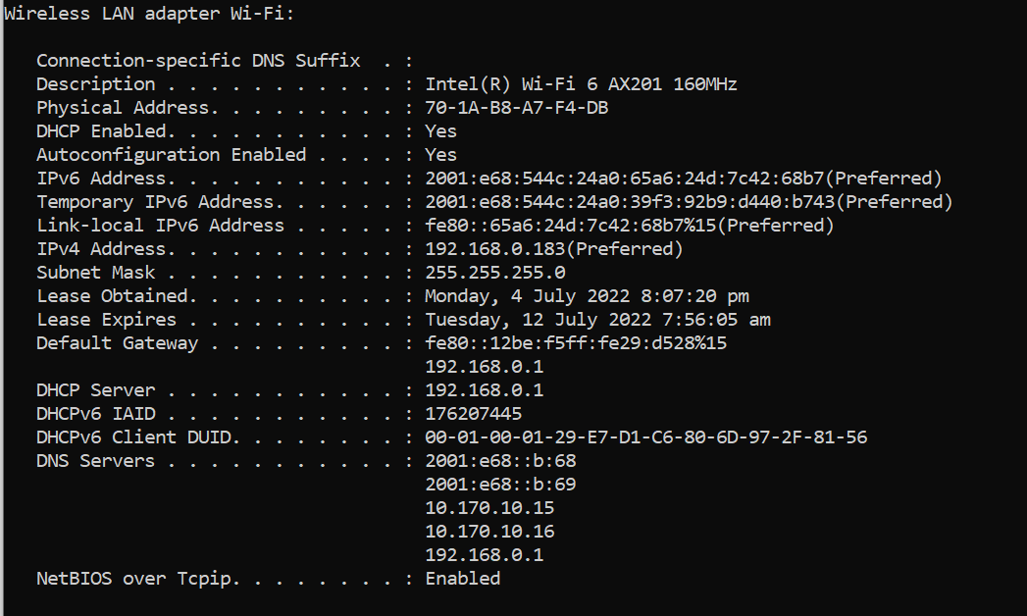
Cloud Print Server
TOSHIBA
Configure desire IP address and host number to be hosted in CloudPrintServer/ CloudPrintServer.js
IP address can be found by using “ipconfig/all” at command prompt

Slide 4
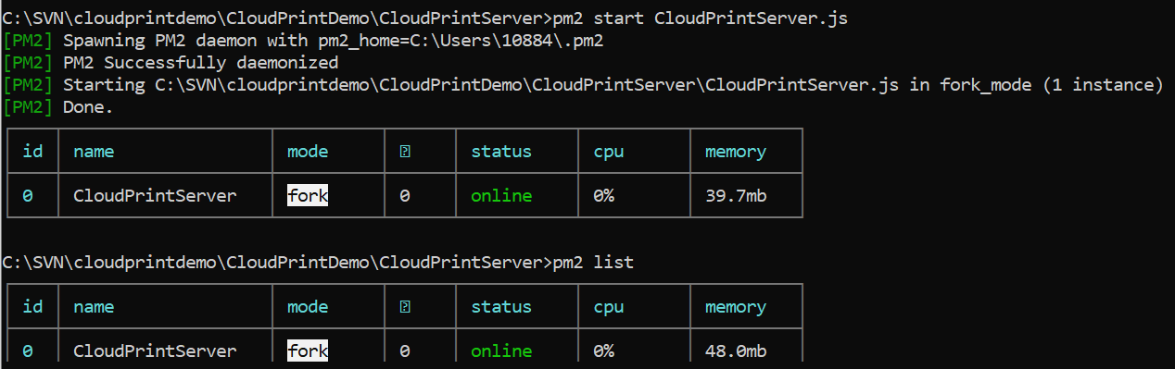
Cloud Print Server
TOSHIBA
Run npm install after copy to local machine
Run pm2 start WebPrintServer.js on command prompt
Check if Cloud print server is successfully hosted by running (pm2 list)

Slide 5
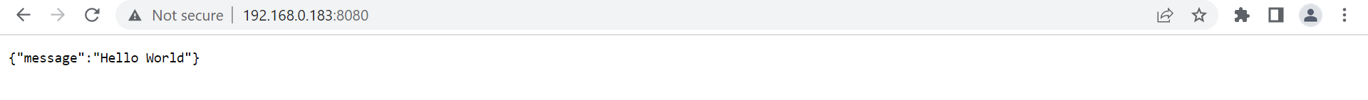
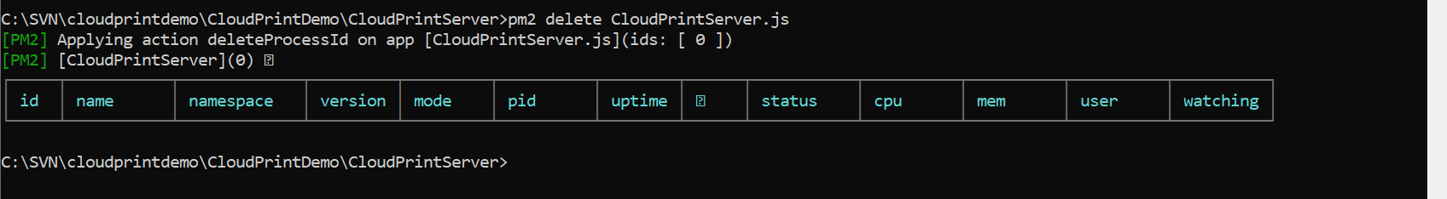
Cloud Print Server
TOSHIBA
Type IP address with port number previously set on the browser and below is the expected result if the server is hosted successfully
If there is file send to server, the file will be saved at CloudPrintServer/uploads before printing
Stop hosting the server by using below command

Slide 6
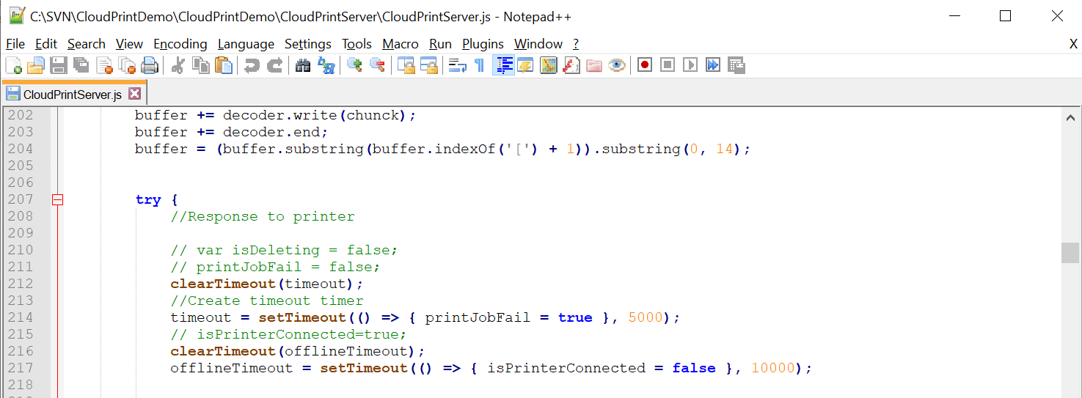
Cloud Print Server
TOSHIBA
There are two timeouts for the cloud print server
timeout -> This will happen after printer lose connection with the server after the set duration
offlineTimeout -> This will happen when the server is hosted and as long as server has no connection with the printer after the set duration
In this example, timeout is set as 5 seconds while offlineTimeout is set as 10 seconds

Slide 7
Cloud Print Client
TOSHIBA
Install node js on local machine https://nodejs.org/en/download/
Install pm2 on local machine using “npm install –g pm2”
Reference: https://pm2.keymetrics.io/docs/usage/process-management/
** If Cloud print server is done setup, please skip above steps
Copy CloudPrintClient folder to local machine

Slide 8
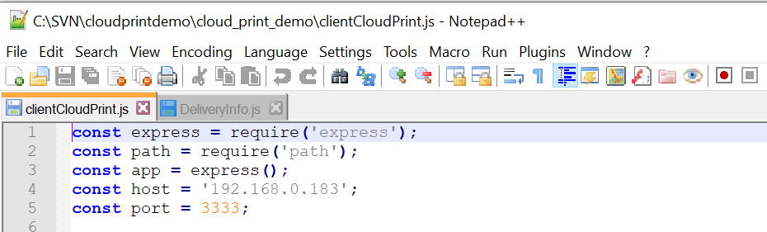
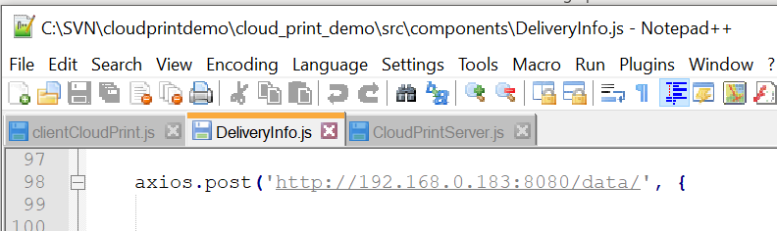
Cloud Print Client
TOSHIBA
Configure desire IP address and port number to be hosted in
/ cloud_print_demo/clientCloudPrint.js
/ cloud_print_demo/src/components/DeliveryInfo.js (cloud print server IP address and port number set in slide no.3)
Replace IP address at Line no.3 (host’s value)
IP address can be found by using “ipconfig/all” at command prompt

Slide 9
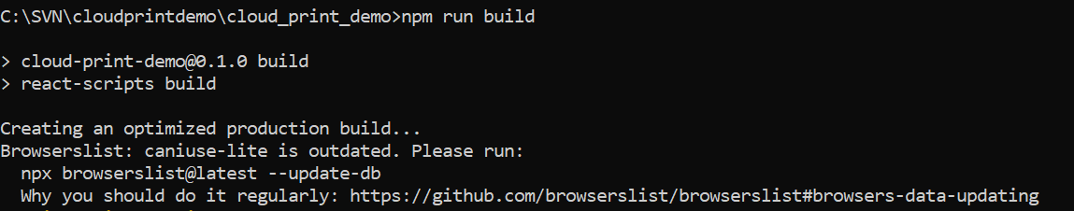
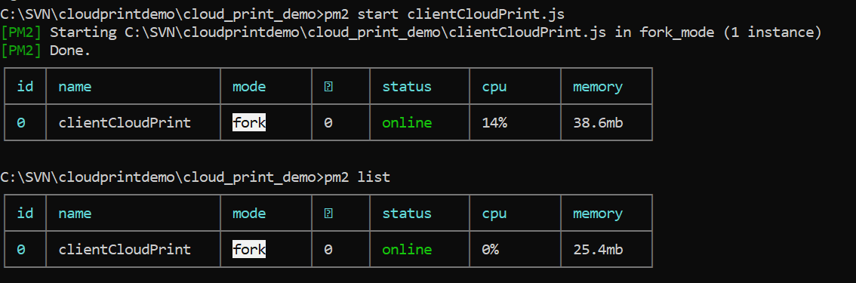
Cloud Print Client
TOSHIBA
Run “npm install” when first copy to the local machine after copy to local machine
Make sure the build is the latest, “npm run build”
Run pm2 start clientCloudPrint.js on command prompt
Check if Cloud print client is successfully hosted by running (pm2 list)

Slide 10
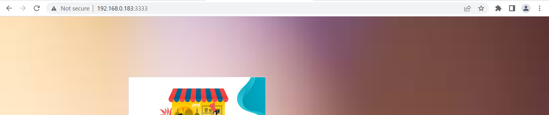
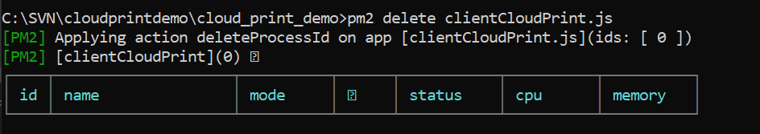
Cloud Print Client
TOSHIBA
Type IP address with port number previously set on the browser and below is the expected result if the server is hosted successfully
Stop hosting the client by using below command

Slide 11
Additional Information
TOSHIBA
Run npm install after copy project file to local machine
Use “pm2 start clientCloudPrint.js” to host cloud print client will not require command prompt to open all the time.
e.g: Accidentally close command prompt will prevent hosting the server/ client
Using pm2 also able to host multiple client/ server under one command prompt window.
Use “node .\clientCloudPrint.js” or “npm start”(local host) to host cloud print client will be affected if command prompt window is closed.

Slide 12
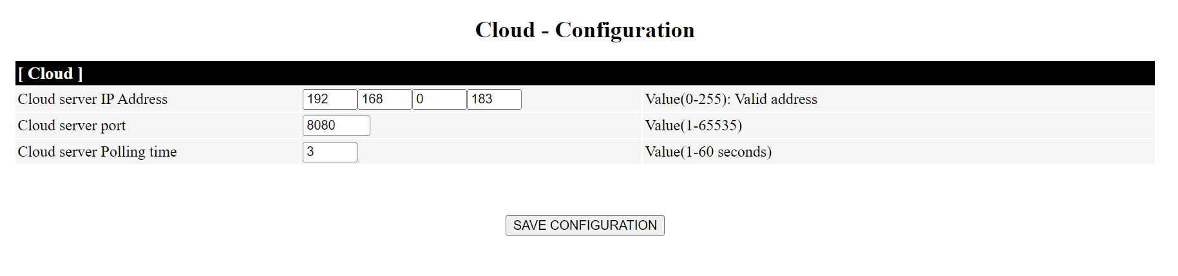
Printer Setup
TOSHIBA
Flash firmware T0C24 ( inside release package) on Tardis printer
Once printer is flashed, connect printer to modem router using lan cable
Browse printer web configuration on browser and you are able to find cloud configuration at the bottom of the page
Set the IP address, port number and polling time that printer send post request to the server

Slide 13
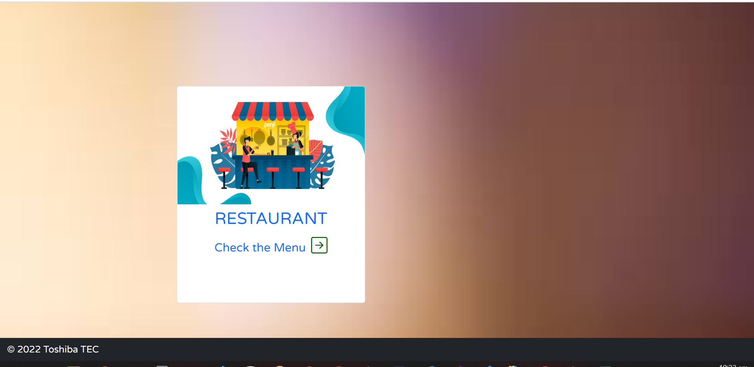

Cloud Print Demo Application
TOSHIBA
- After cloud print client is hosted, you shall be able to see the Home page by browsing the predefined IP address and port number.
- Click the white card to visit Product page.

Slide 14
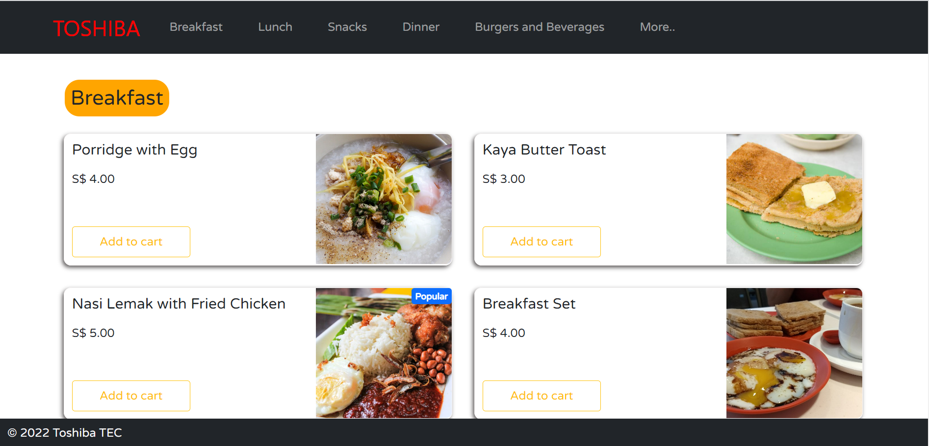
Cloud Print Demo Application
TOSHIBA
In the product page, there’s a menu of the food.
Click “TOSHIBA” will bring you back to the Main page
Click item under navigation bar will bring you to the respective food category

Slide 15
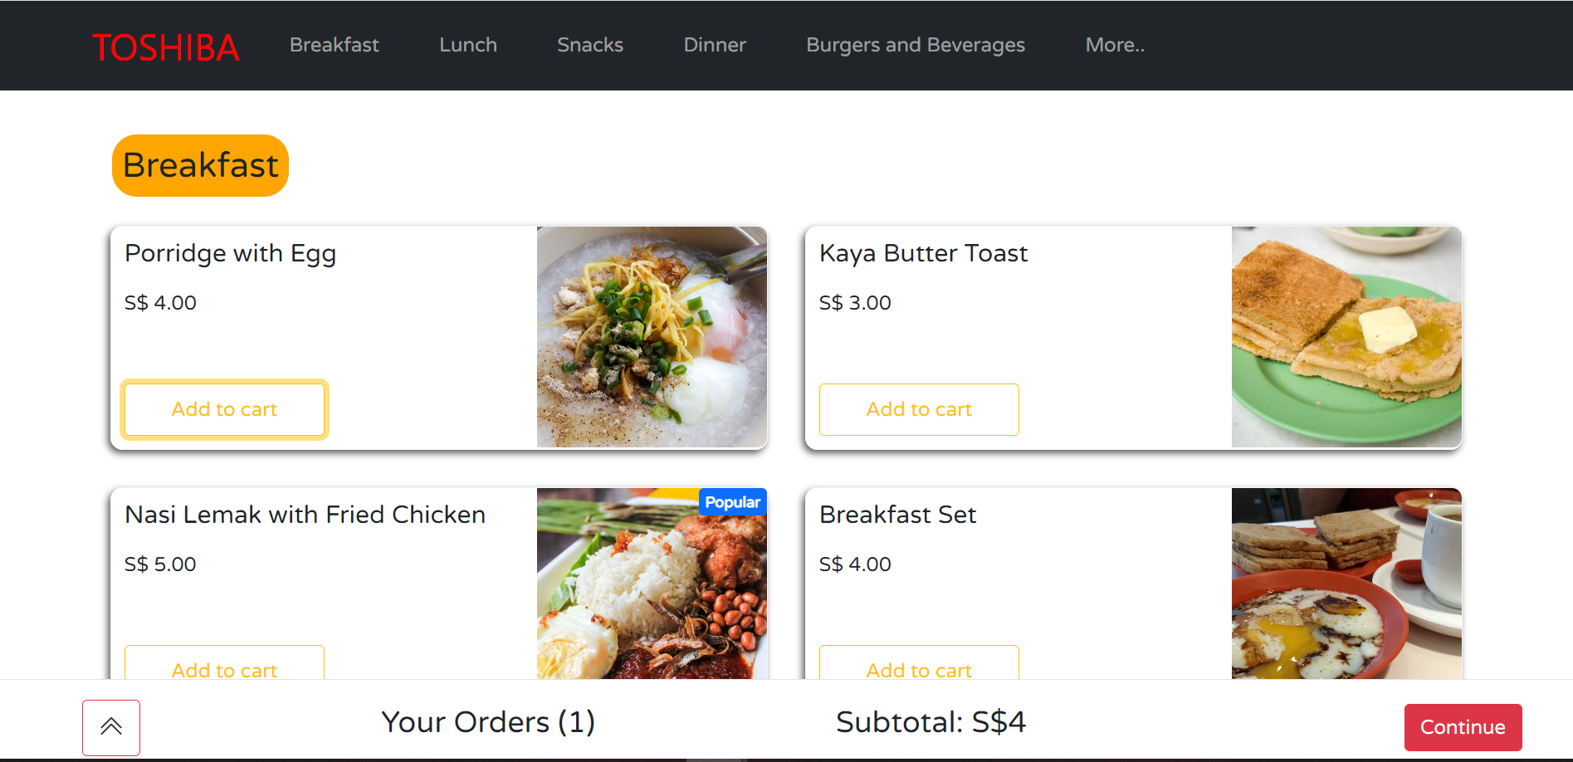
Cloud Print Demo Application
TOSHIBA
Click “Add to cart” will add item to the cart
More items can be added to the cart or edit the items in the cart by clicking the double caret button

Slide 16
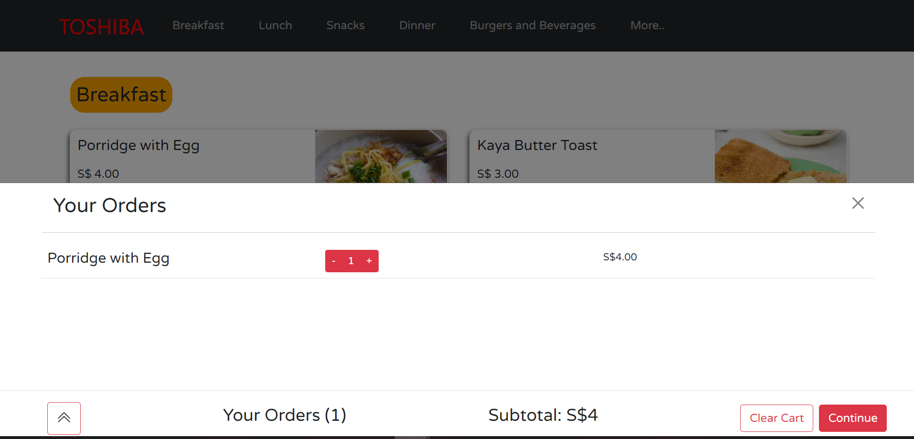
Cloud Print Demo Application
TOSHIBA
The quantity of the item added to the list can be increased/ decreased by pressing the +/-
Click the “Clear cart” button to clear all the items in the cart
Click “Continue” to visit Payment page

Slide 17
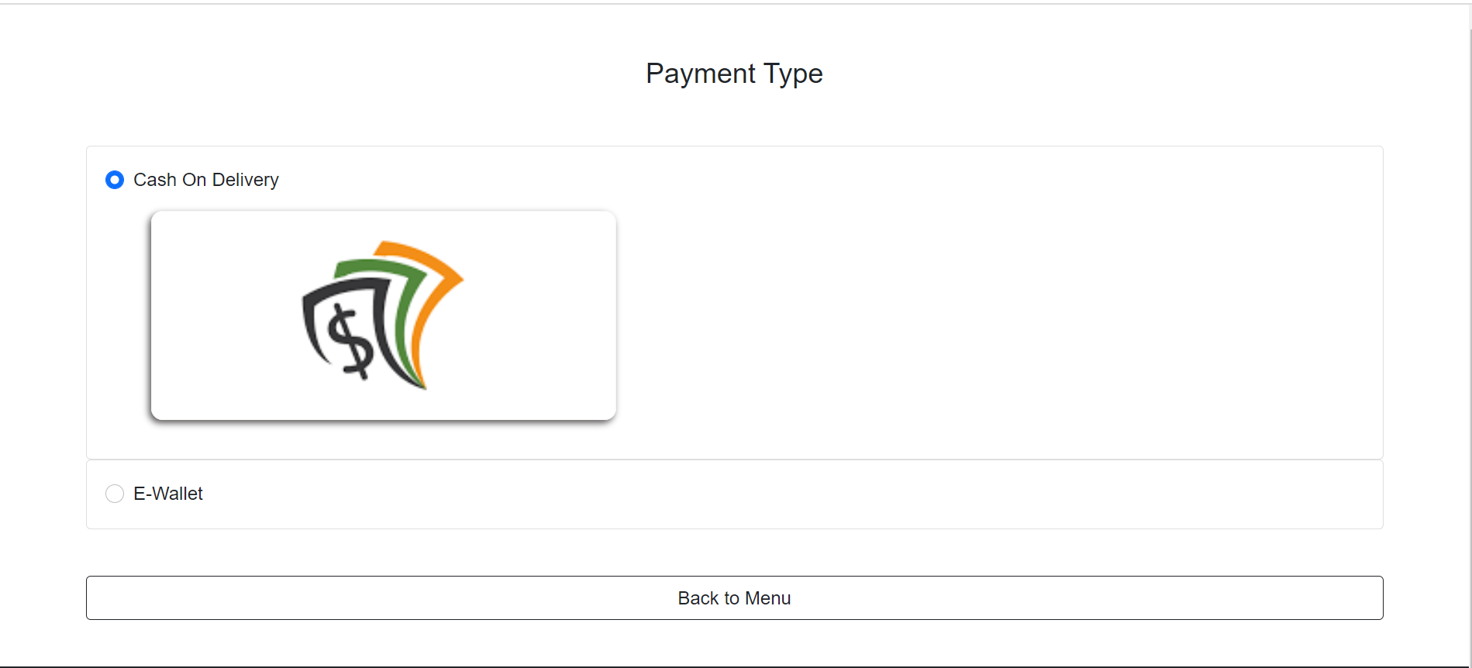
Cloud Print Demo Application
TOSHIBA
Under “Cash on delivery” button, there’s “only cash payment option
Under “E-wallet” button, there are Paynow, Apple pay and etc
Selected any payment type from the radio button to visit Checkout page
Click “Back to menu” to return to product page

Slide 18
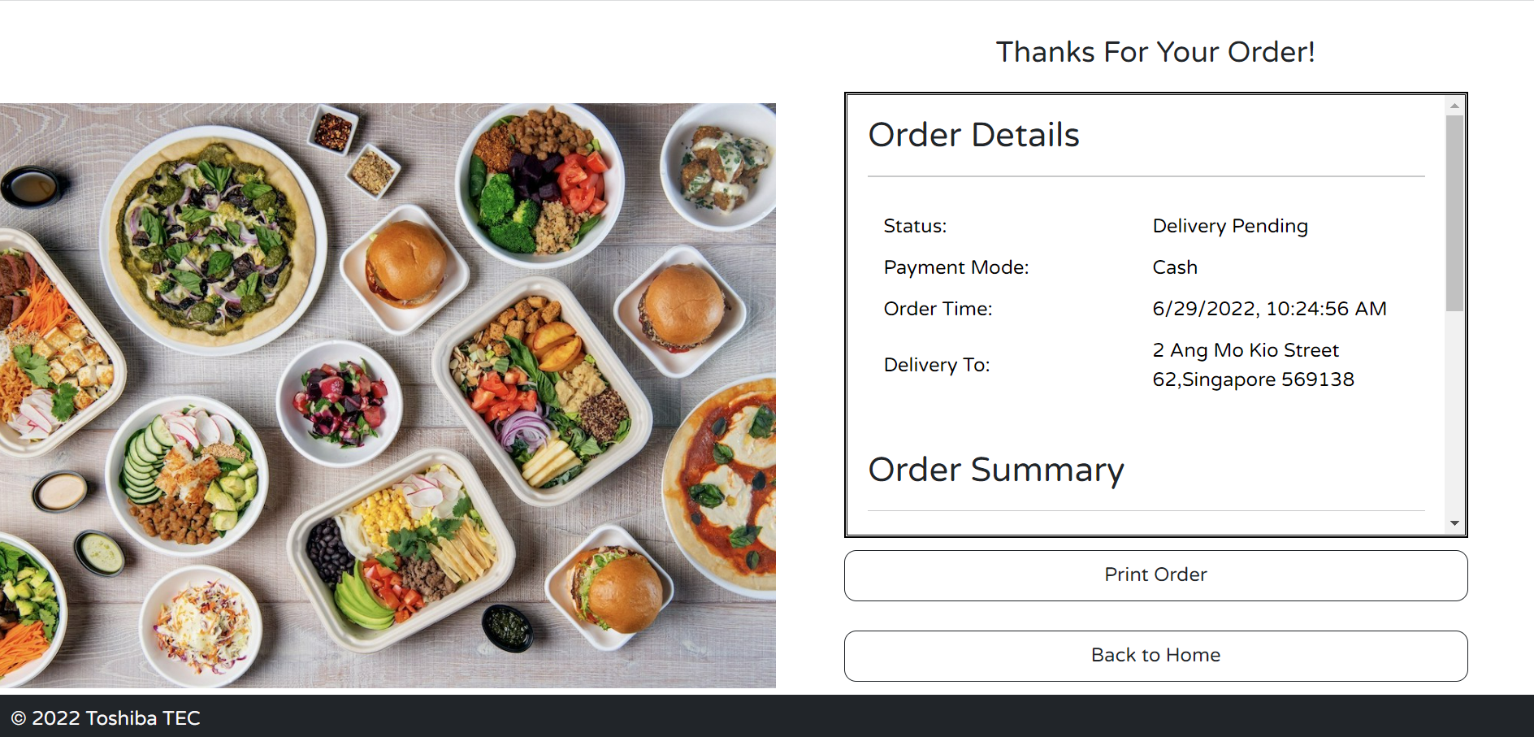
Cloud Print Demo Application
TOSHIBA
Once one of the payment method is pressed, checkout page shall be displayed as below
Click “Print order” to sent the print job to the cloud print server
Click “Back to home” to return to the Home page

Slide 19
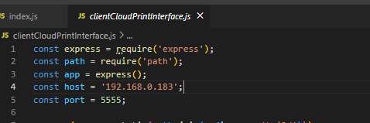
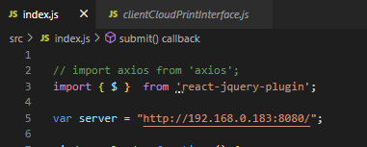
Client Side Interface
TOSHIBA
Purpose: Upload binary file to CloudPrintServer/uploads
Copy cloudPrintClientInterface to local machine
Configure the client side interface IP address and port number in clientCloudPrintInterface.js
Configure the cloud print server IP address and port number in index.js
Run “npm install” on command prompt after copy to local machine
Make sure the build is the latest, “npm run build”
Run “pm2 start cloudPrintClientInterface.js” on command prompt
Check if successfully hosted using “pm2 list”, stop hosting “pm2 delete clientCloudPrintInterface.js”

Slide 20
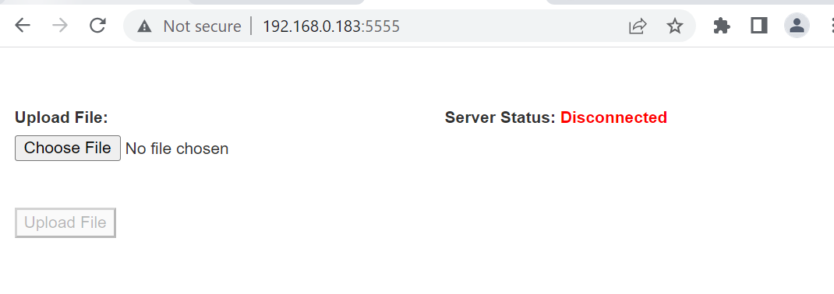
Client Side Interface
TOSHIBA
Below is the interface when the client side interface is hosted
The server status shows disconnected when the server is not hosted and vice versa
Choose binary file from the client browser and click upload file to upload to server

Slide 21
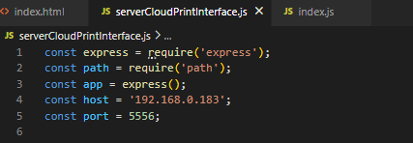
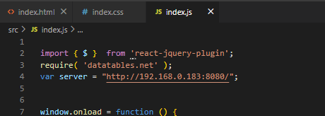
Server Side Interface
TOSHIBA
Purpose: Monitor print job status in cloud print server
Copy cloudPrintServerInterface to local machine
Configure the server side interface IP address and port number in cloudPrintServerInterface.js
Configure the cloud print server IP address and port number in index.js
Run “npm install” on command prompt after copy to local machine
Make sure the build is the latest, “npm run build”
Run “pm2 start cloudPrintServerInterface.js” on command prompt
Check if successfully hosted using “pm2 list”, stop hosting “pm2 delete cloudPrintServerInterface.js”

Slide 22
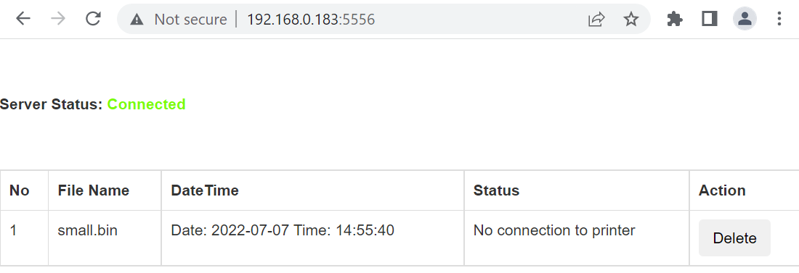
Server Side Interface
TOSHIBA
Below is the interface when the server side interface is hosted
The server status shows disconnected when the server is not hosted and vice versa
File name, upload time, print job status (In progress, printer error status, timeout, disconnect)
Delete button is only disabled when the server is trying to send print to printer

Slide 23
Thank you!
TOSHIBA

